Slide 1
Lecture 4
Advanced Contract Concepts: Build your own Blockchain

Slide 2
Function Deep Dive

Slide 3
Function Convention
function getASum (uint a, uint b) public pure override returns (uint) checkSize {}
Declaration
Function Name
Inputs
Visibility
Mutability
Override
/Virtual
Output Type
Custom Modifiers
These are optional

Slide 4
Function Visibility
public Function is callable by anyone, including other contracts and itself. | private Function can only be executed within its contract. Cannot be inherited or externally called.
internal Function can only be called by its contract and the contracts which inherit the contract it lives in. | external Function will only ever be called by external users and contract, not by the contract itself internally. It is cheaper than public functions as it accesses calldata.

Slide 5
Principle of least Authority
“If a program has authority it does not need, that authority will eventually be abused — accidentally or otherwise.”
— Norman Hardy
1. Private - will this function/variable only be used within this contract?
2. Internal - Would child contracts need to call this function/variable?
3. External - Is this value only for external users?
4. Public - A value/function that should be completely open the public?

Slide 6

Function Mutability
pure No state variable will be changed or read. | view State variable will be read but not changed.
Combined with "external", the function is free!

Slide 7

Function inheritance - virtual / override
Here are my functions
I do my own thing!!!
I will mark my function as "virtual"
I mark my function as "override"
Interface Functions are automatically virtual
Private Functions cannot be inherited
In the case of Multiple Inheritance, with parents who have functions with the same name, child contract MUST override the function with the same name!

Slide 8
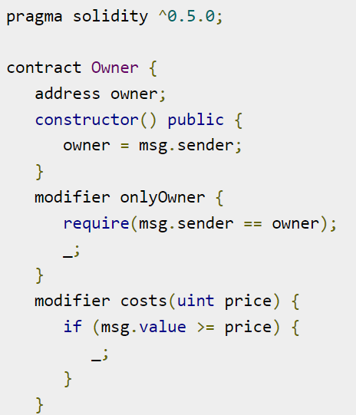
Custom Function Modifiers
Declare using the "modifier" keyword.
_; signals start of main function
Modifiers properties:
Can be inherited
Can take arguments
Many in same function
Can be overriden

Slide 9
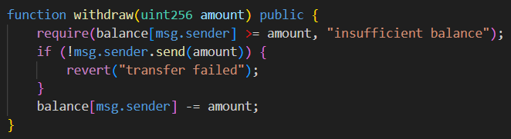
Validation and Assertion
require(cond), require(cond, error_msg) is used to check inputs
revert(), revert(msg) is used to abort execution given internal errors
assert(cond) is used to prevent logical errors like integer overflow
Source: https://www.linkedin.com/pulse/require-vs-revert-assert-solidity-arslan-maqbool/

Slide 10
Function Overloading
function sameName(int a){}
function sameName(int a, string b){}
function sameName(int a, int b){}
A function with multiple, different inputs but the same function name is an overloaded function.
Functions may be overload with:
A different number of inputs
Different types of inputs
How does this work? Function Signatures -> 4 Byte Hashes
Notes:
Example code here

Slide 11
Special Functions

Slide 12


External call - Talk to other contracts
(bool success, bytes memory data)= receivingAddress.call{gas: limit; value: wei}("");
Can call specific function signature (ie. different payment methods)
Empty function directly calls fallback or receive function
Can specify gas limit or use all gas in calling contract. Enables complex operations
Function params encoded with abi.encodeWithSignature
What happens when the called contract makes a call to the original calling contract?

Slide 13
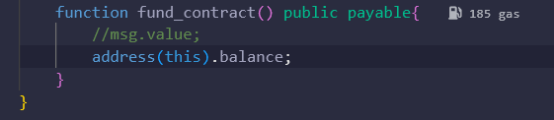
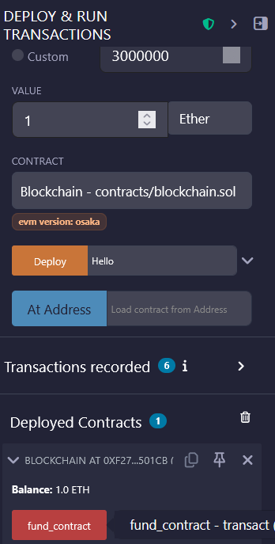
Paying contracts and functions - payable keyword
Set the "value" field to send money to function
Red functions are payable

Slide 14
Fallback, Receive
receive() external payable{}
First line of defense
All money paid to the contract
fallback() external payable{}
Second line of defense
Does NOT contain the function keyword
MUST be external and payable
Can be virtual overridden and contain modifiers

Slide 15
Globally Available Variables
Block, Transaction

Slide 16
Block properties
blockhash(uint blockNumber) returns (bytes32): hash of the given block when blocknumber is one of the 256 most recent blocks; otherwise returns zero
block.basefee (uint): current block’s base fee (EIP-3198 and EIP-1559)
block.blobbasefee (uint): current block’s blob base fee (EIP-7516 and EIP-4844)
block.chainid (uint): current chain id
block.coinbase (address payable): current block miner’s address
block.difficulty (uint): current block difficulty (EVM < Paris).
block.gaslimit (uint): current block gaslimit
block.number (uint): current block number
block.prevrandao (uint): random number provided by the beacon chain (EVM >= Paris)
block.timestamp (uint): current block timestamp as seconds since unix epoch

Slide 17
Transaction Properties
msg.data (bytes calldata): complete calldata
msg.sender (address): sender of the message (current call)
msg.sig (bytes4): first four bytes of the calldata (i.e. function identifier)
msg.value (uint): number of wei sent with the message
tx.gasprice (uint): gas price of the transaction
tx.origin (address): sender of the transaction (full call chain)
tx.origin
msg.sender
msg.sender
User → Contract A → Contract B → Contract C

Slide 18
Smart Contract Properties
Inheritance and Memory

Slide 19
Inheritance - sharing is caring
Single
Multi-level
Hierarchical
Multiple
Functions and state variables of parent goes to child
Chain of inheritance, all properties gets cumulatively passed down each generation
A parent can have many children
Inherit from many different contracts
contract parent {}
contract child is parent {}
contract A {}
contract B is A {}
contract C is B {}
contract parent {}
contract child1 is parent {}
contract child2 is parent {}
contract child is parent1, parent2, parent3 {}
Notes:
Sometimes people use this to keep source files manageable and well separated

Slide 20
Variable Scope in Smart Contracts
contract MyContract {
int public a;
mapping(address => int) ownerBalances;
function checkBalance(address _owner) external view {
int b = 5;
return b + ownerBalances[_owner];
}
}
State variables are always stored onchain.
They are inherited
Local variables are in transient memory.
They are not inherited

Slide 21
Memory Management in Smart Contracts
Memory Lasts for the length of a function call Stored on EVM Values are mutable Most versatile | Calldata Extremely tiny User/contract inputs Immutable Use as safe guard
Storage Permanent on chain storage Extremely expensive!! Can use push function Use for state variables only | Stack Very small Stores things for immediate execution Gas Efficient Extremely painful -> inline assembly

Slide 22
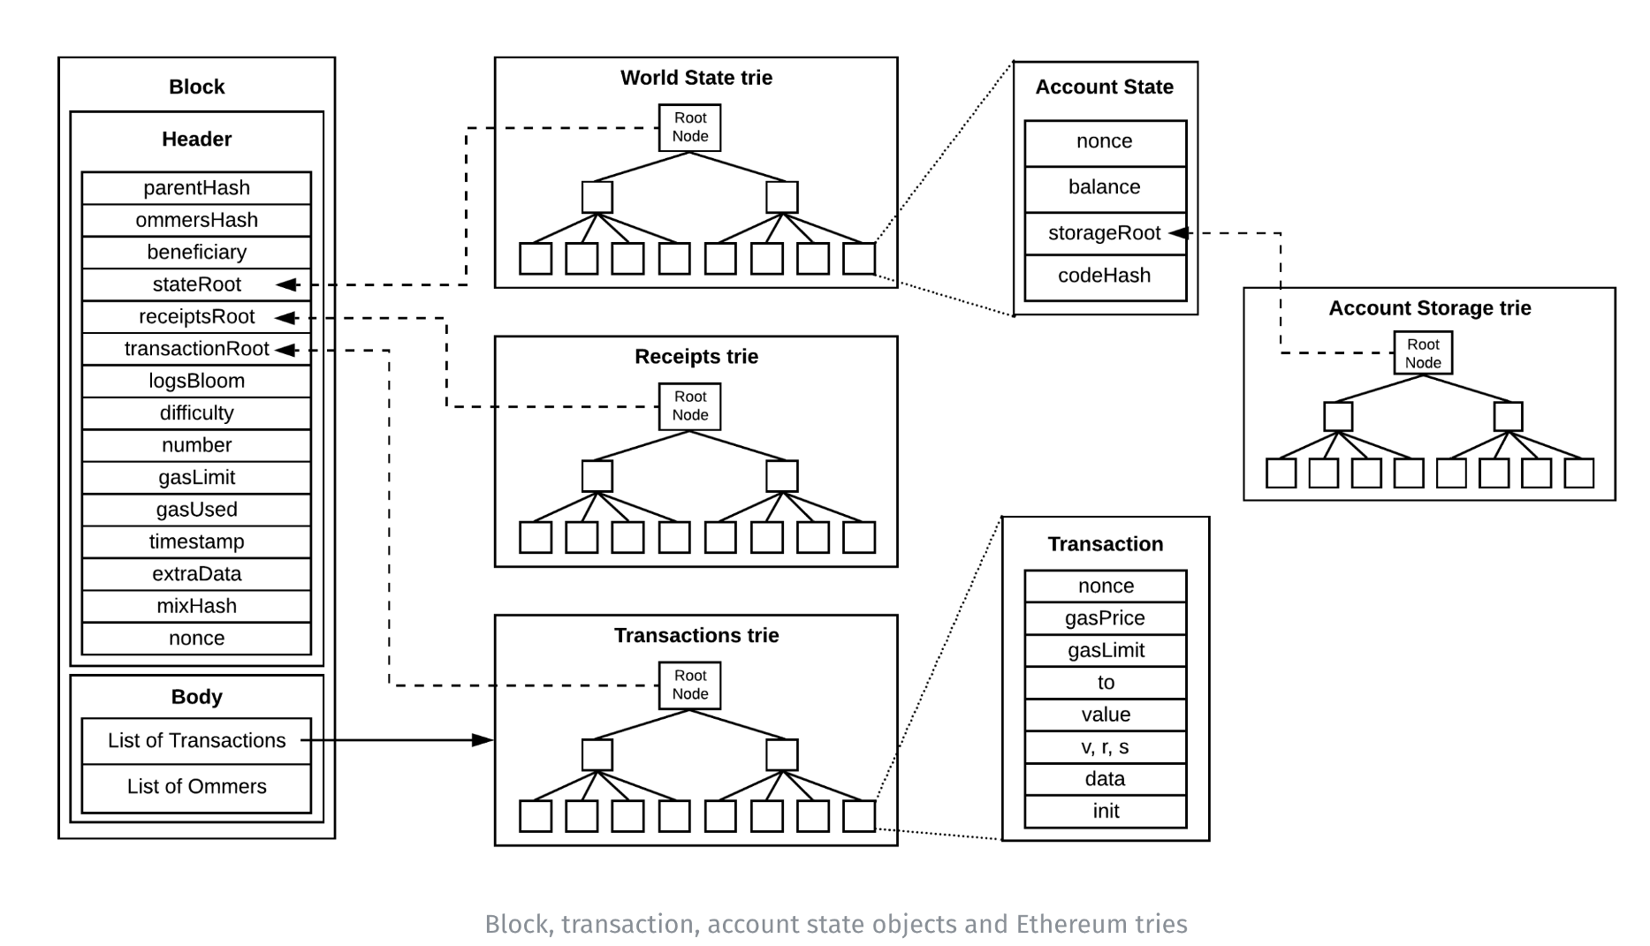
Ethereum Accounting - Tries

Slide 23
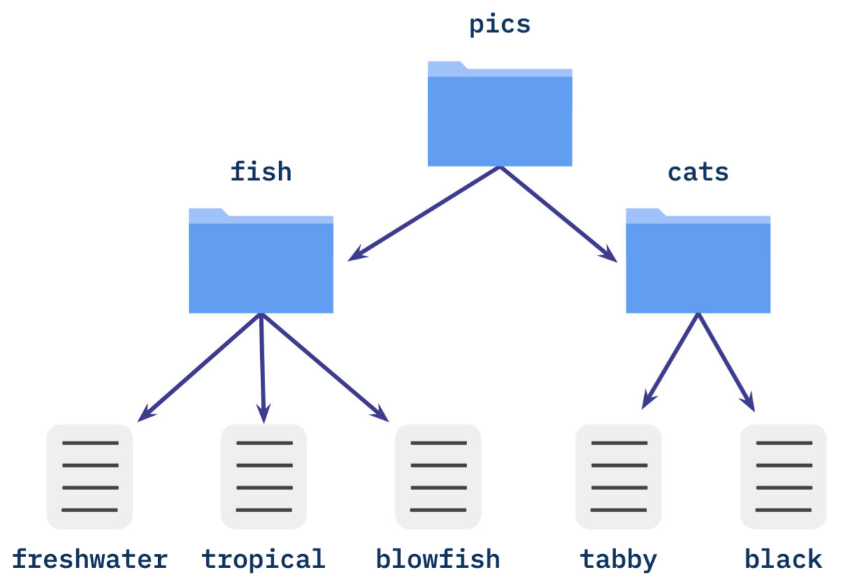

Hashes - the foundation of blockchain
Content is only stored at the bottom layer (leaves)
Any change has a bubble up effect up the branches to the root

